Slide 1
We are Nhân phẩm team
Hello !!!

Slide 2
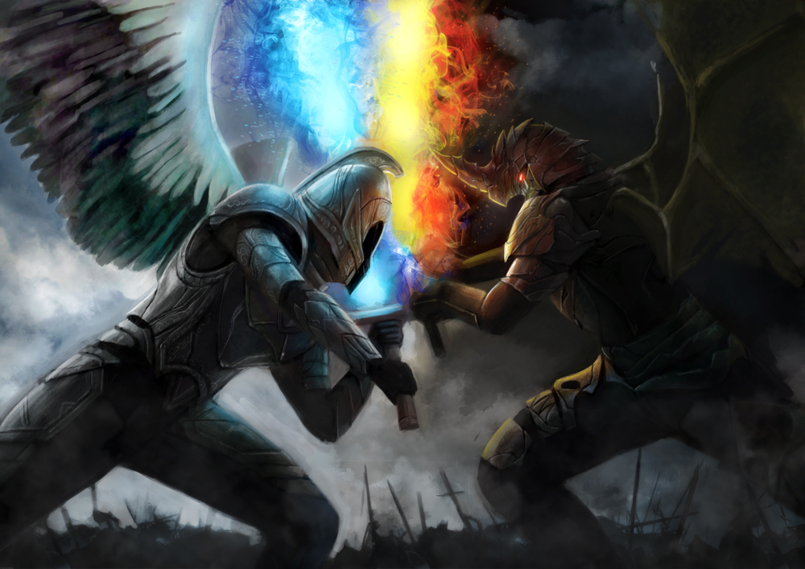
Rise of Evil
A game 2D isometric defense where you build an army and defend
all the attack of evils to save the world.

Slide 3
1.
What is It like ?

Slide 4
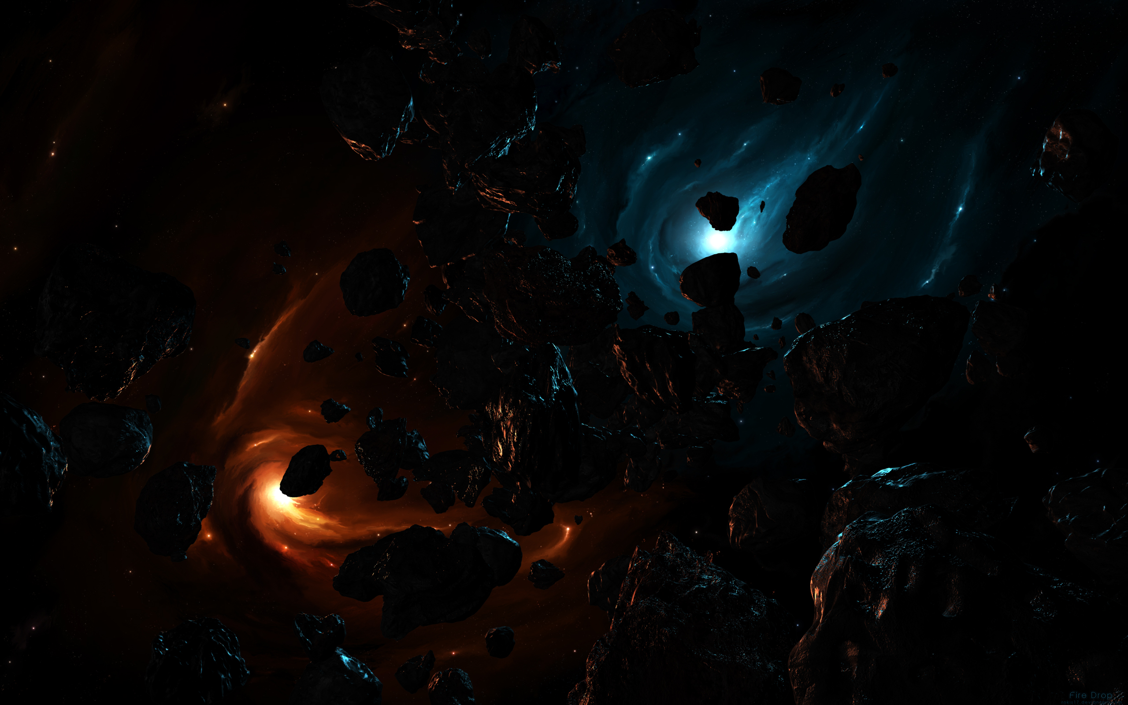
Our game is:
Defense
Campaign, Survival
1 player
Isometric
Touch
Tower building, destroy all enemies
A war between evil and human to decide who will survive

Slide 5
2.
Gameplay

Slide 6
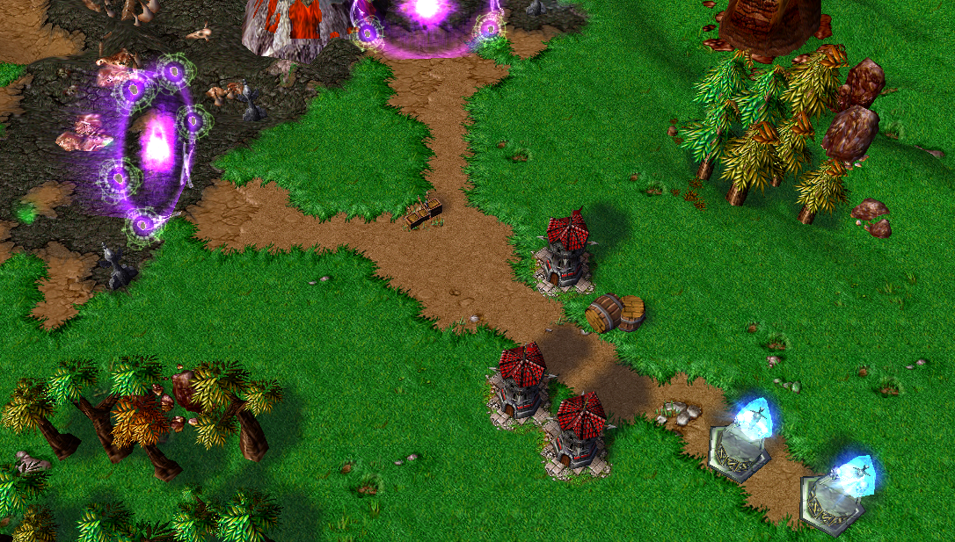
Crytal of King
Tower
Crytal of Life

Slide 7
“What make we different ?”

Slide 8

Our selling point
Monster can destroy your tower
The power of monsters is inversely proportional to the HP of Crystal of King
Your life will not reset after you finish a stage
Remaining gold from previous stage will push to next stage

Slide 9
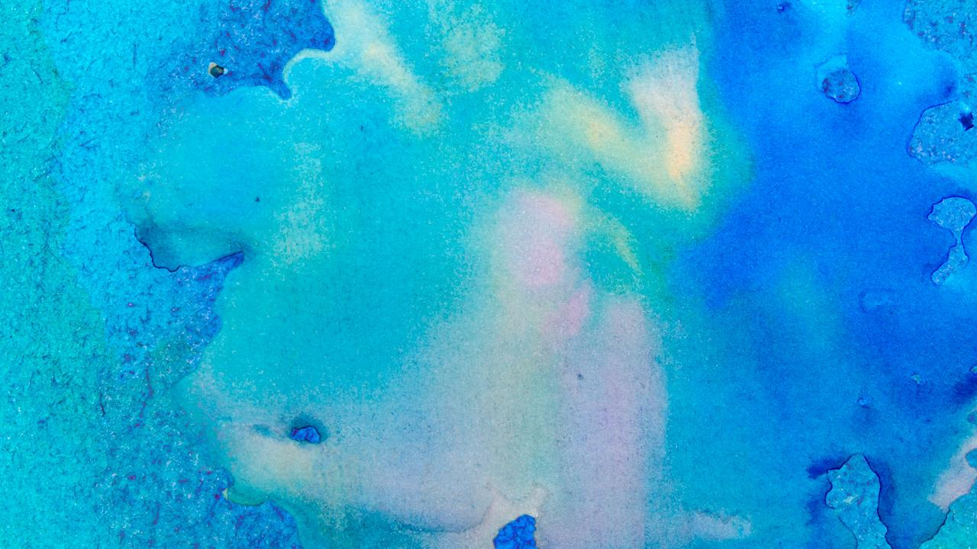
Game map

Slide 10

Thanks!
Any questions?
Contact my team.

